Slide 1

Snowflake Cloud DW Training
CLOUD DATA WAREHOUSE TRAINING

Slide 2
Snowflake the Redeemer
Trainer – Sreenivas Kalahasti
SnowPro Certified Practitioner
Lead Data Architect – Multinational Investment Bank
17 years of experience in IT industry
3 years of rich experience in Snowflake
Started as Oracle Database Developer
Worked on most of the popular ETL tools and BI Tools
Worked as a Lead Big Data Warehouse Engineer
Worked everywhere SQL Query is used
Ran behind the fancy word “Data Scientist”
Tried to become Big Data Engineer
Randomly tried Snowflake and working as a
Full time Snowflake Architect

Slide 3
Agenda of this Demo
Evolution of Data Analysis(Warehouse) - Conventional DWH
Evolution of Data Analysis(Warehouse) - Big Data DWH Data Lake
Difference between Conventional DWH and Big Data based Data Lake
Challenges of a DWH technologist to adapt to Big Data
Challenges of a company which is using Big Data
Snowflake the next gen of Big Data
What is required to change your career
Challenges in becoming a Data Scientist or Big Data Engineers
What is needed to start my career in Snowflake DB
What else I can add to make my career better along with Snowflake DB
Register a Free Snowflake Account of $ 400 worth for practicing our snowflake hands on

Slide 4
Evolution of Data Analysis(Warehouse) - Conventional DWH
Properties | Comments
Birth of Data Warehouse | Early 2000
Products for storing the Data | Data Stored in RDBMS like Oracle, SQL Server , CSV Files
Products used for Data Processing | ETL – Informatica Power Centre, Data Stage, SSIS, BODS
Products used for BI | Crystal Reports, Business Objects, Microstrategy, SSRS
Source of Data | Internal Products , CRM
Structure of the Data | Structured data stored in Relational Database
Required knowledge to work | SQL , PL/SQL ( Oracle ) , T-SQL ( SQL Server )
Data Loading Frequency | Batch
Example of Products | Identify Potential Customers, Fixing Revenue Leakage

Slide 5
Evolution of Data Analysis(Warehouse) - Big Data DWH Data Lake
Properties | Comments
Birth of Big Data | Early 2010
Products for storing the Data | Data Stored in open formats like HDFS, CSV Files
Products used for Data Processing | Earlier MapReduce and now it is Spark
Products used for BI | Micro strategy and PowerBI
Source of Data | Internal Products , CRM and Social Media
Structure of the Data | Semi - Structured and Un-Structured data stored in HDFS Eco System
Required knowledge to work | Mostly Java. After the demise of Mapreduce, Spark supports Scala and Python
Data Loading Frequency | Batch and Live
Example of final products | Live systems like Validate Fraudulent Transaction, Recommender Systems

Slide 6
Difference between Conventional DWH and Big Data based Data Lake
Properties | Data Warehouse | Big Data
Required knowledge to work | SQL , PL/SQL ( Oracle ) , T-SQL ( SQL Server ) | Mostly Java. After the demise of Mapreduce, Spark supports Scala and Python
Data Loading Frequency | Batch | Batch and Live
Implementation of ETL | Using Informatica, Datastage, Ab Initio or Within the Database | Using Java, Scala, Python
Target Products | Reactive Products. Because the customer left the premises. | Pro-Active Products. Because the customer is still in the premises
Example of Products | Identify Potential Customers, Fixing Revenue Leakage | Live systems like Validate Fraudulent Transaction, Recommender Systems
Data Formats | Only structured and which can be stored in RDBMS | Semi-Structured and Un-Structured.
Storage Formats | Mostly CSV and Proprietary format of Oracle/ MS SQL Server | RC, ORC, AVRO, Parquet, JSON, CSV and XML
Maximum Size | Few Tera Bytes | Multi Peta Bytes
Technologies used | Oracle, Teradata, MS-SQL Server , My-SQL | HDFS Echo system, Mapreduce, Spark, Kafka

Slide 7
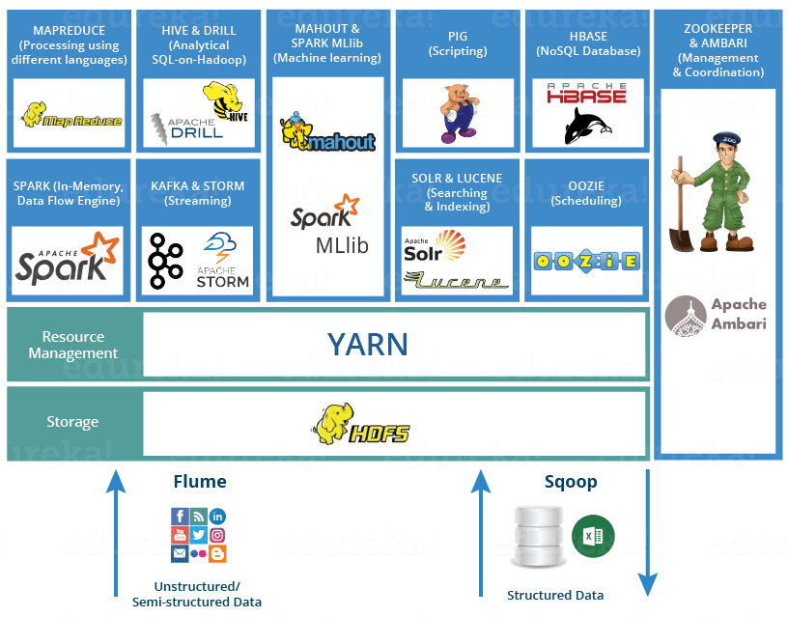
Challenges of a DWH technologist to adapt to Big Data

Slide 8
Fragile because it is an eco-system
Maintenance is hard. Patching and upgrading is hard
Performance needs manual intervention
Finding the Technical resource
Finding the Data Scientist
Managing the HDFS Cluster which is an open source
Inability to reuse the people who worked in conventional DWH
Rare resource means high salary
Challenges of a company which is using Big Data

Slide 9
Properties | Big Data | Snowflake
Technical background needed to operate | Java, Scala, Python | SQL ( Python in extreme use case )
Supported Data Formats | Structured, Semi-Structured and Unstructured | Structured and Semi-Structured. Unstructured is not supported
Live Data Streaming | YES ( Using Kafka) | YES ( Using Kafka )
Product Stability | Fragile because it is eco-system | Easy because all the features are integrated
Product maintenance | DevOPs will have sleepless nights | It is a SAAS product. So, patching, Upgrading , Provisioning are seemless
Performance | Need manual intervension | In-Built. No or near No manual intervention is needed
Data Transformations | Can be handled only using scripts | GUI tools are available for ETL ( DBT, IICS , Matillion , Streamsets etc )
Supported Size | In case of On-Prime it is restricted. For Cloud it is near infinite | Near Infinite
Resource availability | Hard to find and hard to train | Easy to find and easy to train
Salary | Extremely high | Higher than the market standard
Use cases | Most of the real time systems | Real time and batch systems
Snowflake the next gen of Big Data

Slide 10
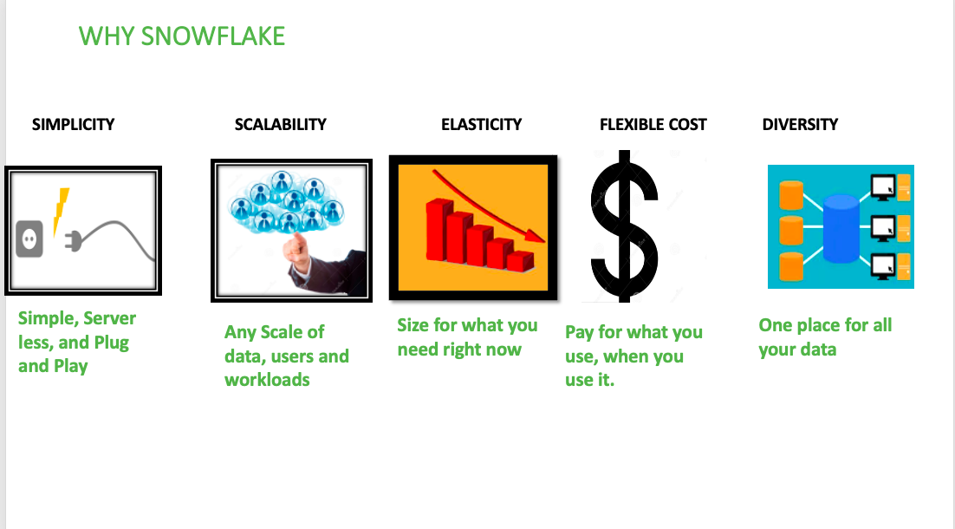

Slide 11
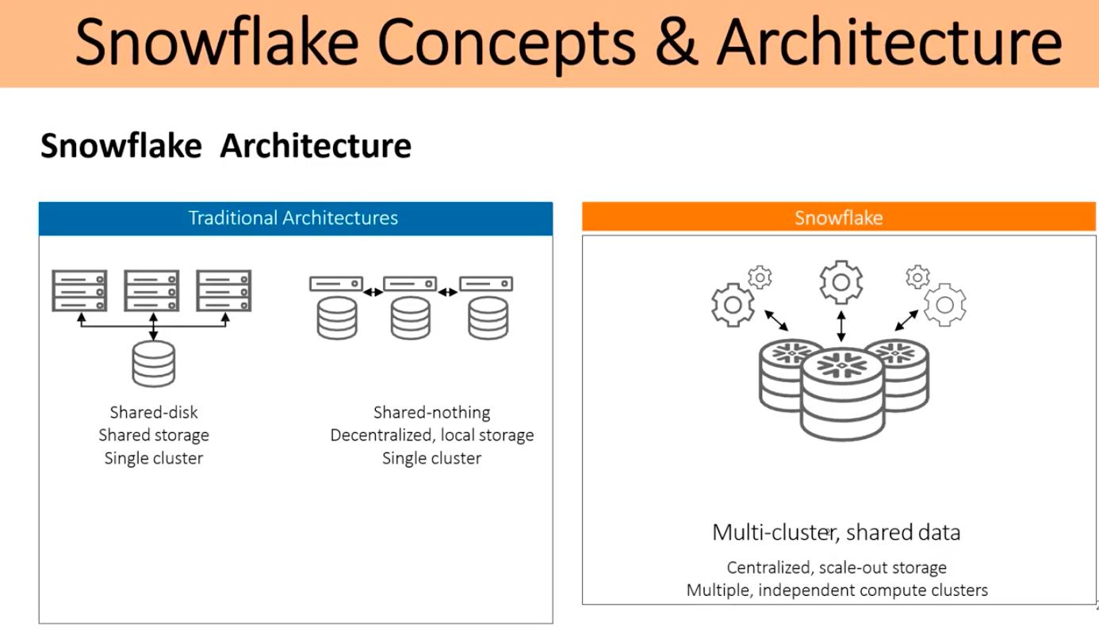

Slide 12
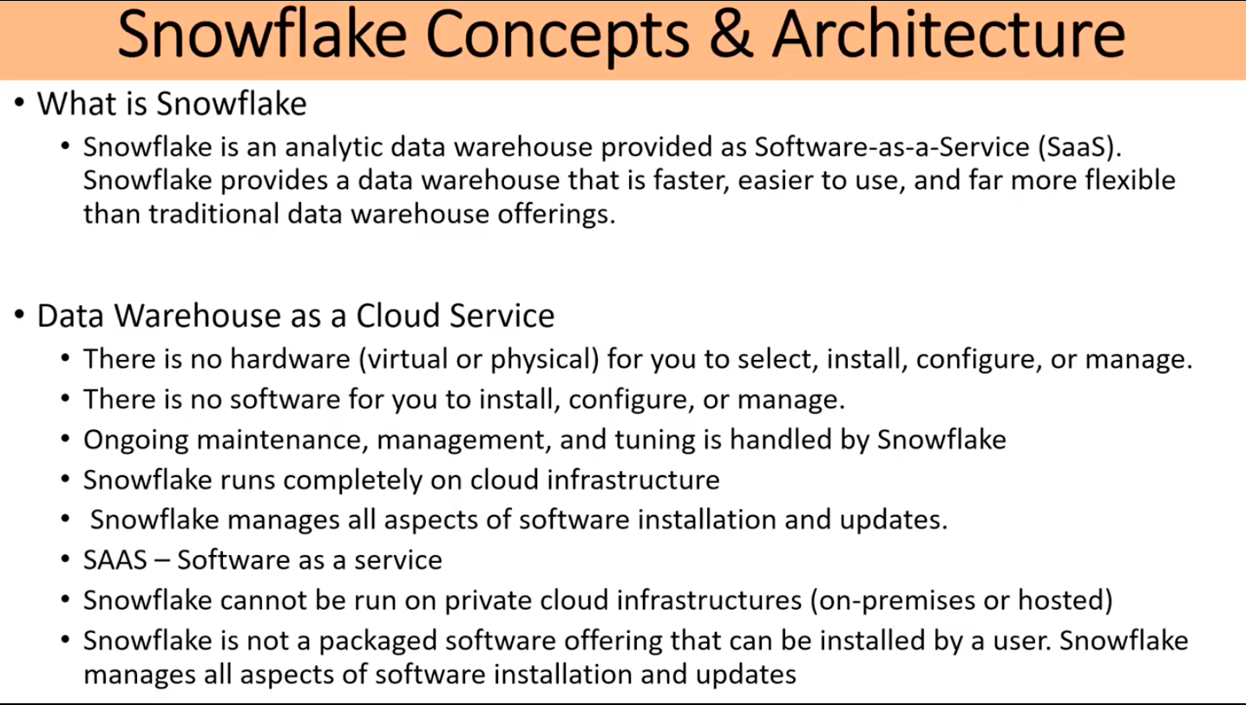

Slide 13
Features of Snowflake Data Warehouse
•Security and Data Protection: Snowflake data warehouse offers enhanced authentication by providing Multi-Factor Authentication (MFA), federal authentication and Single Sign-on (SSO) and OAuth. All the communication between the client and server is protected y TLS.
•Standard and Extended SQL Support: Snowflake data warehouse supports most DDL and DML commands of SQL. It also supports advanced DML, transactions, lateral views, stored procedures, etc.
•Connectivity: Snowflake data warehouse supports an extensive set of client connectors and drivers such as Python connector, Spark connector, Node.js driver, .NET driver, etc.
•Data Sharing: You can securely share your data with other Snowflake accounts.

Slide 14
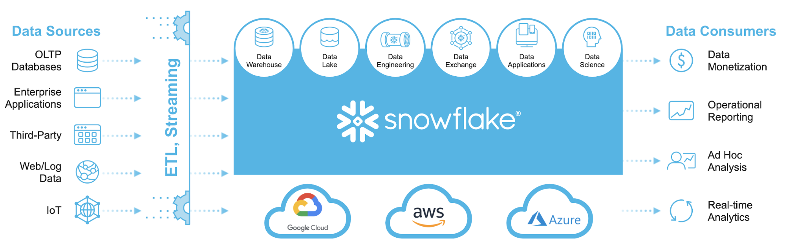

Slide 15
What is needed to start my career in Snowflake DB
Should be Proficient in SQL
Should be good at DWH concepts
Fair knowledge in ETL or Oracle PL/SQL ( or Closely with any database) concepts
Cloud knowledge is NOT mandatory ( Minimum required knowledge is taught in the training )
Maximum total IT experience can be 20 years, provided the right attitude is shown

Slide 16
What else I can add to make my career better along with Snowflake DB
Modern ETL Tool | Outdated ETL Tools | Cloud Provider | Customization Language
Streamsets | Data Stage | Azure | Python
Matillion |  | GCP
DBT |  | AWS
Informatica – IICS | Informatica Power Centre

Slide 17
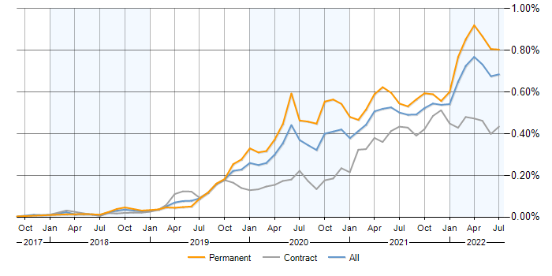
Snowflake Cloud DW Job Market

Slide 18
Project based guidance
Task based training.
Will share a sample project.
Will quickly discuss the required snowflake topics to implement the project
and Add Merge it into your CV
This option requires you struggle to find out the answers and implement things on yourself, which is REAL TIME exposure.

Slide 19
Questions?

